Slide 1

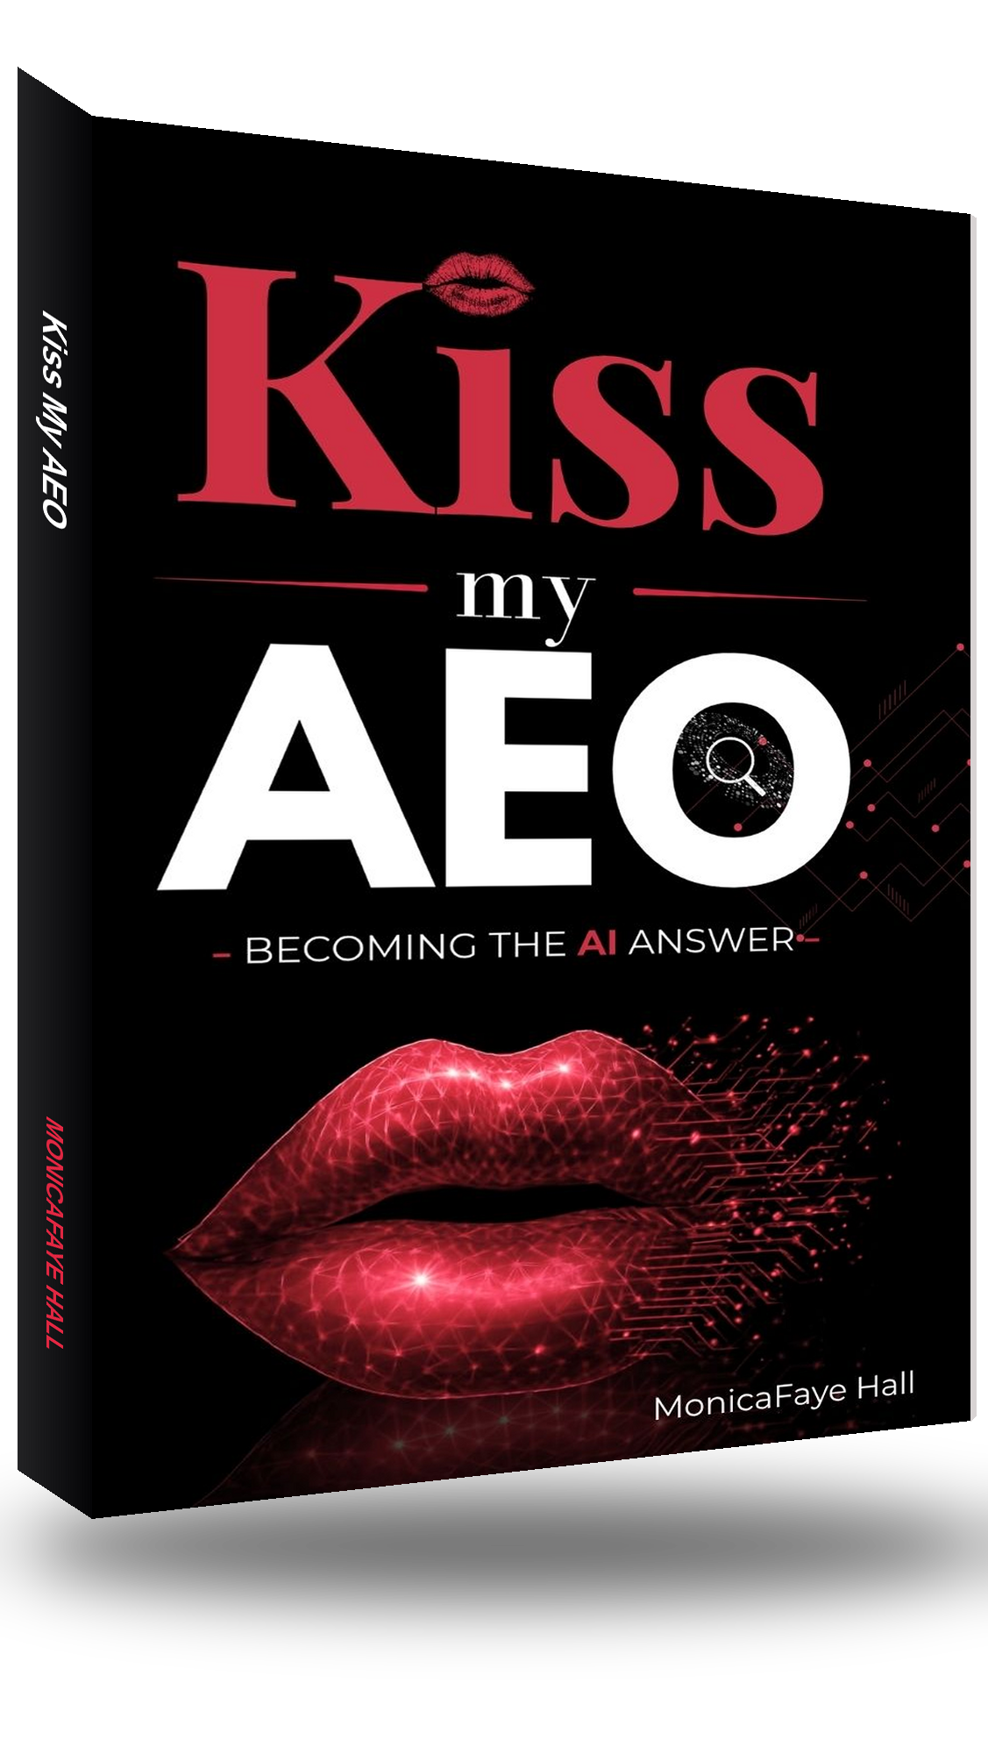

MEDIA & SPEAKER ONE-SHEET
KISS MY AEO
Becoming the AI Answer · MonicaFaye Hall
In the age of AI, visibility isn't enough. You have to be the answer.
ABOUT MONICAFAYE HALL
MonicaFaye Hall brings more than 20 years in digital marketing and e-commerce, with certifications from Google, Microsoft and HubSpot. A former developer and Fortune 500 e-commerce director, she is the founder of SERPfinity, an AI-search visibility platform, and owner of The Digital Hall. She is the author of Kiss My SEO and E-Commerce Management, and co-author of Ladies in Tech & Friends, Vol. IV. Her work has been featured in Entrepreneur and CNN Underscored. In Kiss My AEO she turns two decades of search and e-commerce experience into a practical discipline for becoming the answer that AI platforms and search engines recommend.
DROP HEADSHOT
1.62 × 1.85 in
INTERVIEW & TALKING POINTS
What Answer Engine Optimization actually is — and how it differs from traditional SEO
Why citations now matter more than blue-link rankings
The trust signals AI platforms evaluate before they recommend a brand
How search optimization drove 600%+ revenue growth
The SEO practices to stop doing in 2026
BOOK FACTS
TITLE
Kiss My AEO
SUBTITLE
Becoming the AI Answer
AUTHOR
MonicaFaye Hall
ISBN
979-8-90600-520-5
FORMATS
Paperback, Ebook, Audiobook
PUBLICATION
2026 (date TBA)
CATEGORY
Business & Economics / Marketing / Search
AUDIENCE
Marketers, founders, e-commerce and SEO teams
Headshots, logo pack and brand style guide: monicafayehall.com/monicafaye-hall-speaker-kit/
MonicaFaye Hall · info@monicafayehall.com · 804.452.7772 · monicafayehall.com
Notes:
ONE-SHEET FOR BOOKERS — US Letter. Drop a portrait into the frame at left. All live text. Palette: black 090407, crimson E02742.

